Slide 1
Home
Document Camera
Stand

Slide 2
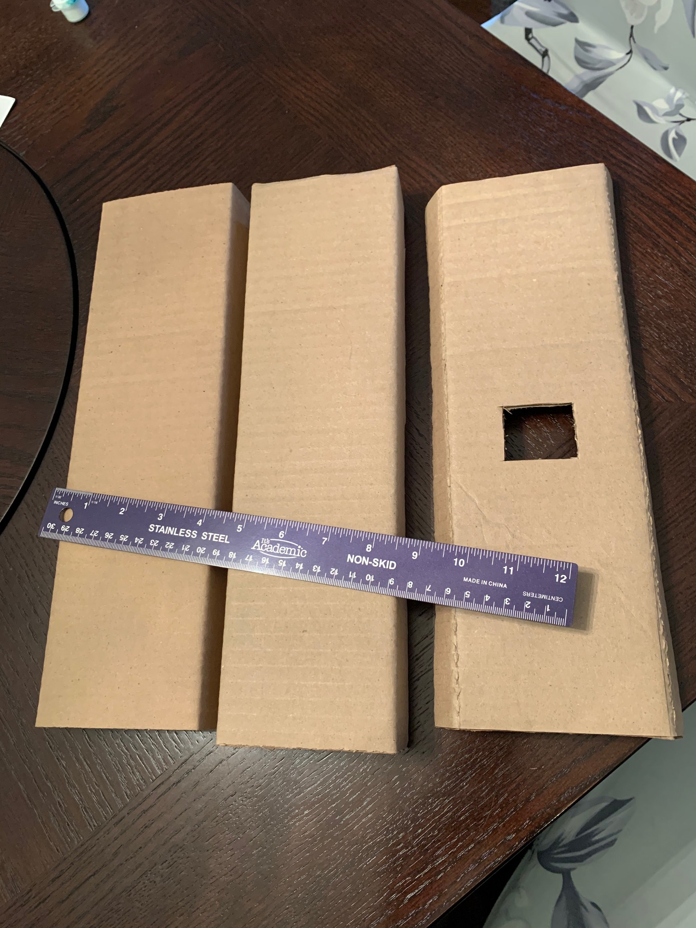
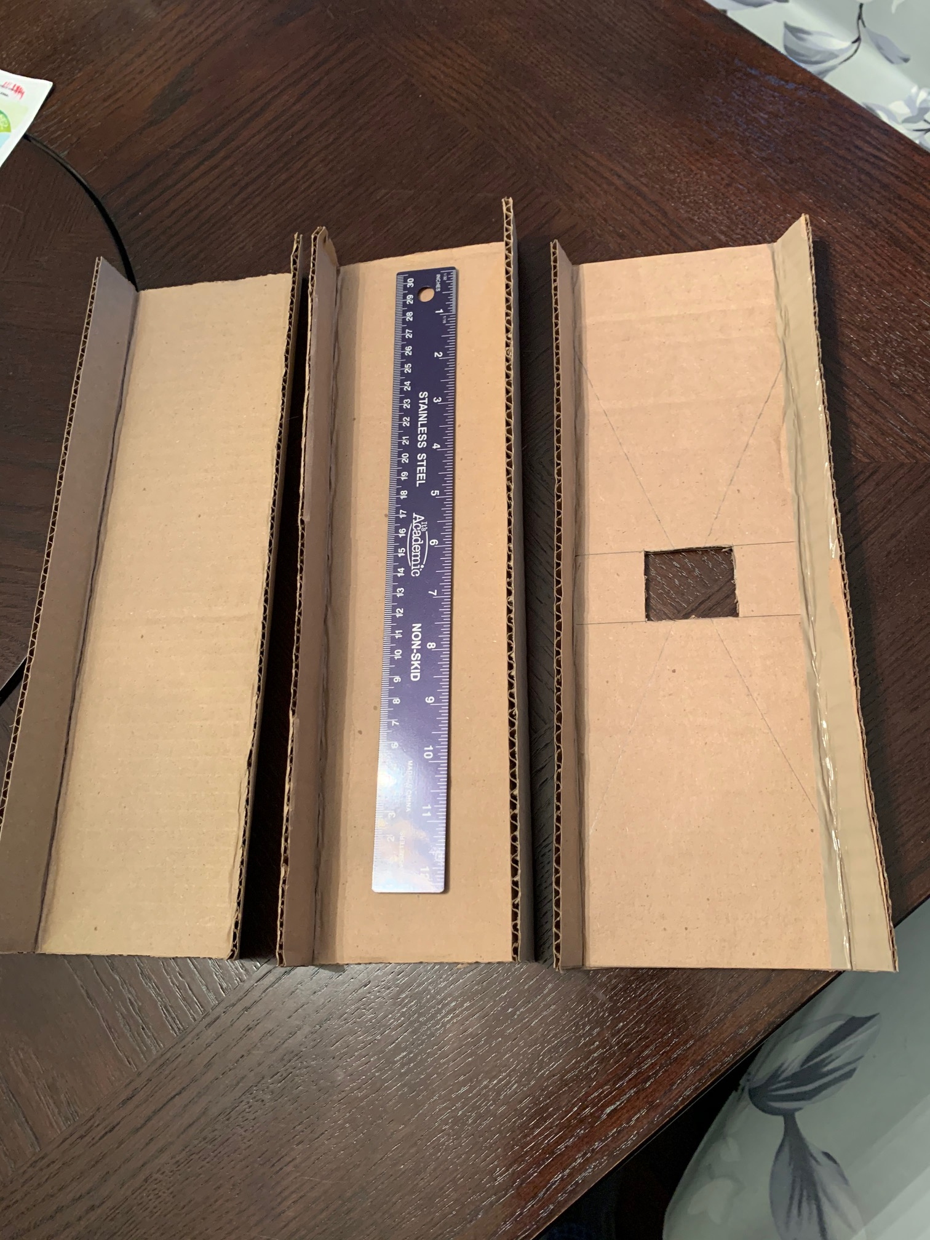
Start with three pieces of cardboard each 12 in. long and 6 in wide. Fold 1 in wide tabes along the long sides of all three pieces. Cut a centered 1.5 in square hole in the center of one piece.
Dimensions can be adjusted to fit available cardboard.

Slide 3
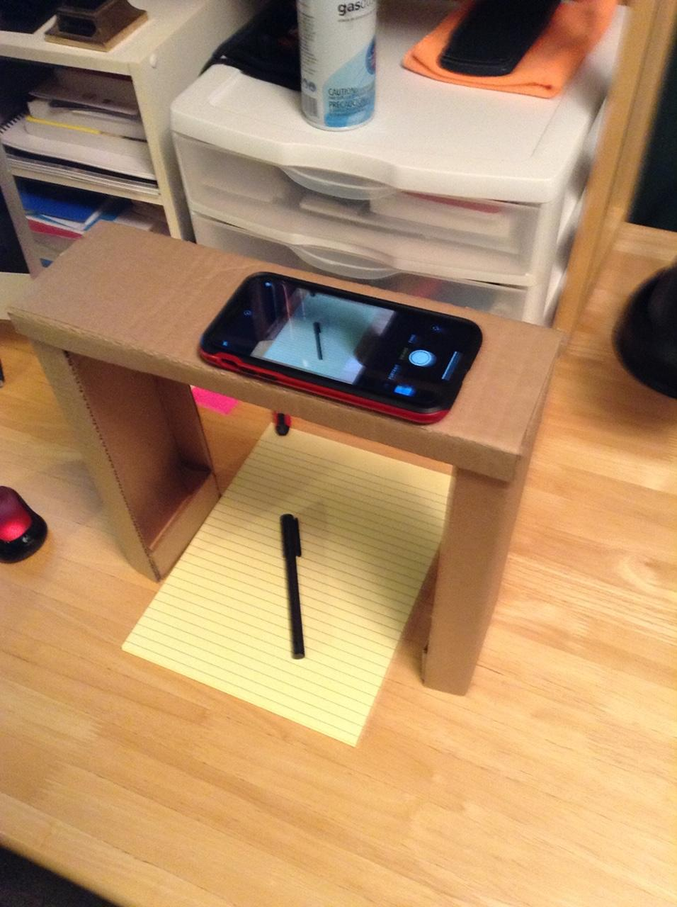
Use glue (I used hot glue), tape or staples to assemble the document camera as seen on the right. The build is finished.

Slide 4
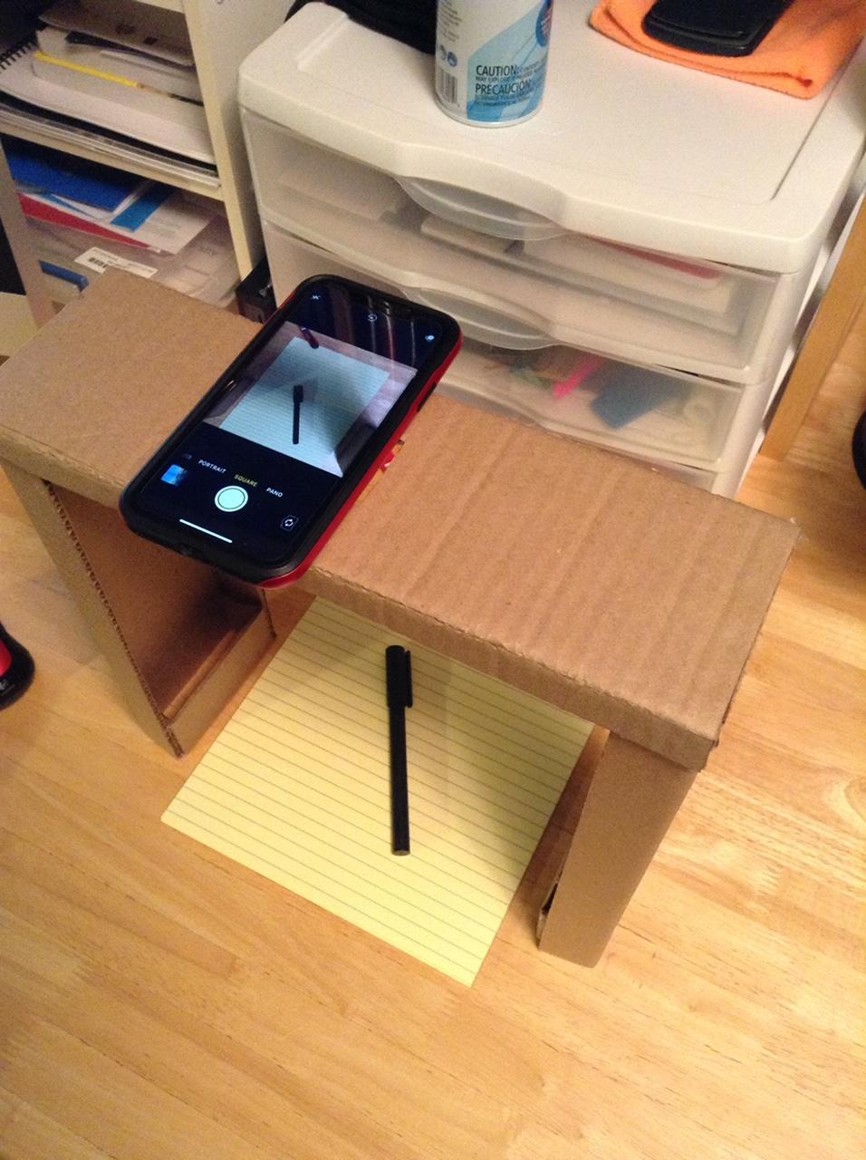
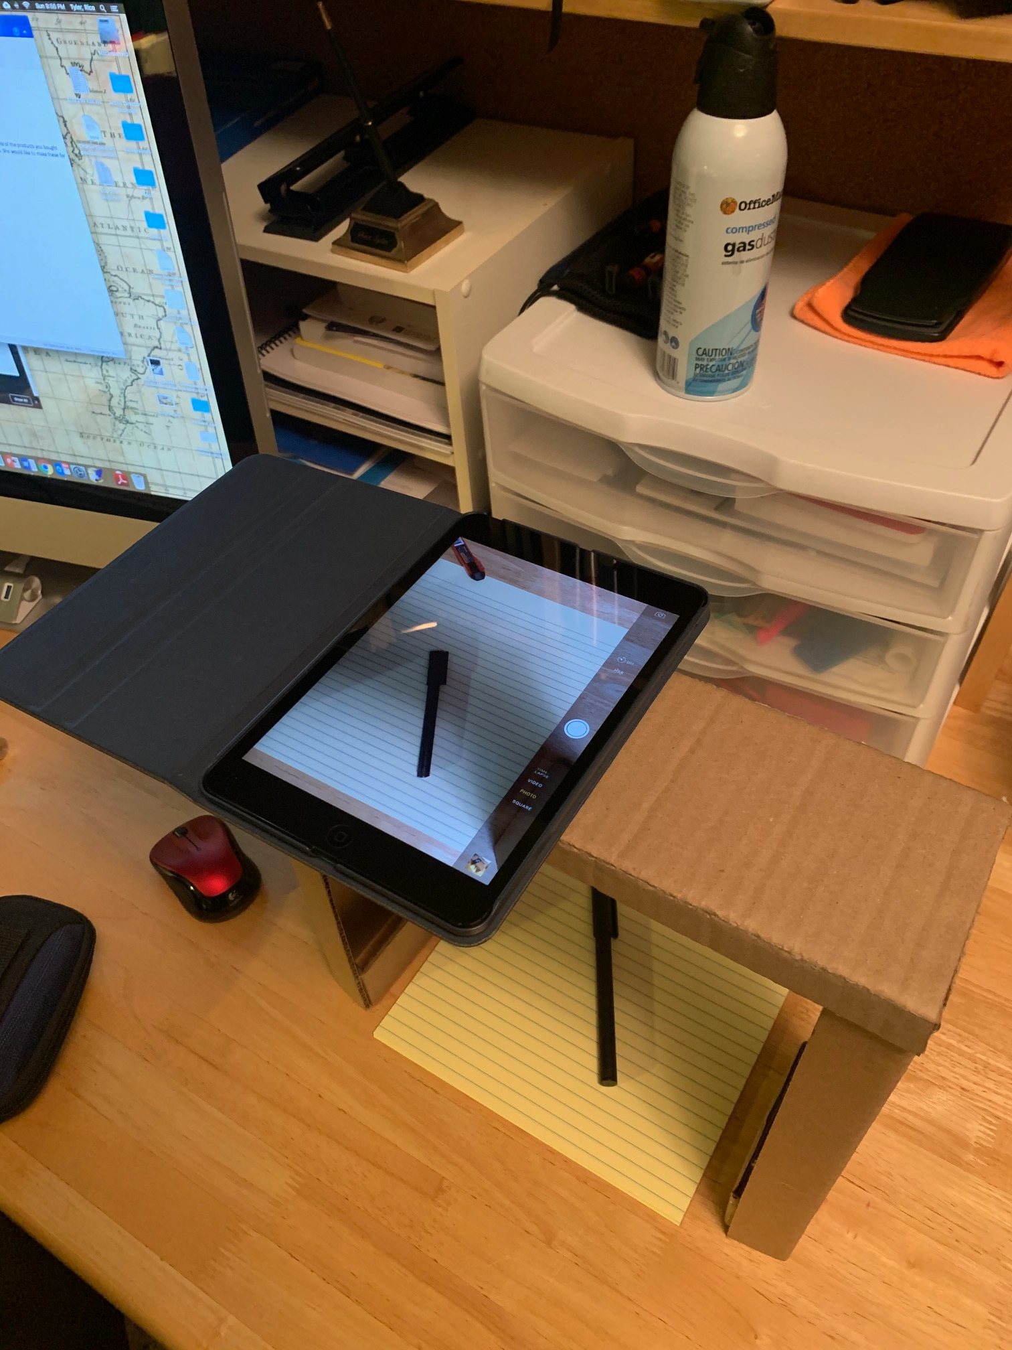
The completed document camera can hold a range of smartphones and tablets in different positions.

